Slide 1
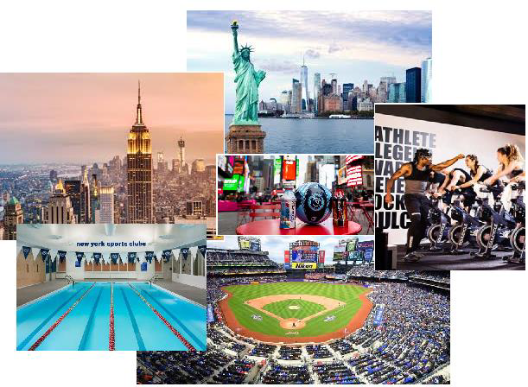
Exploring New York City Sports Venues
Thomas Jacobs
25 June 2020

Slide 2
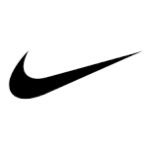


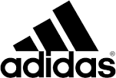



Introduction
People are more health conscious
Take part in various sport activities
To reach their ultimate physical potential
Other reasons such as self-improvement, health improvement
Booming sports nutrition and sports equipment market
Big players

Slide 3
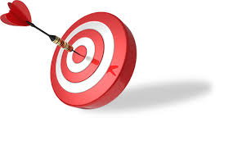
Introduction
It is critical for a small, start-up company in this industry to ensure that it targets its products at the right target audience for optimal impact.

Slide 4
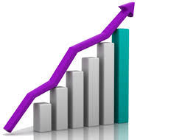
Problem Statement
The marketing team of the start-up is highly skilled and experienced
They are not local to New York and are not familiar with the different neighbourhoods.
Constraint marketing budget
Maximum Return-on-Investment

Slide 5
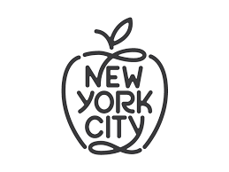
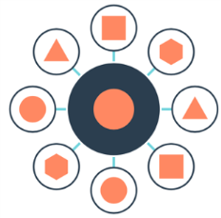
Value Proposition
Assist the marketing team in understanding their target area
To develop the best marketing strategy for their portfolio of products.
New York City will be clustered into the optimal number of different sports clusters

Slide 6
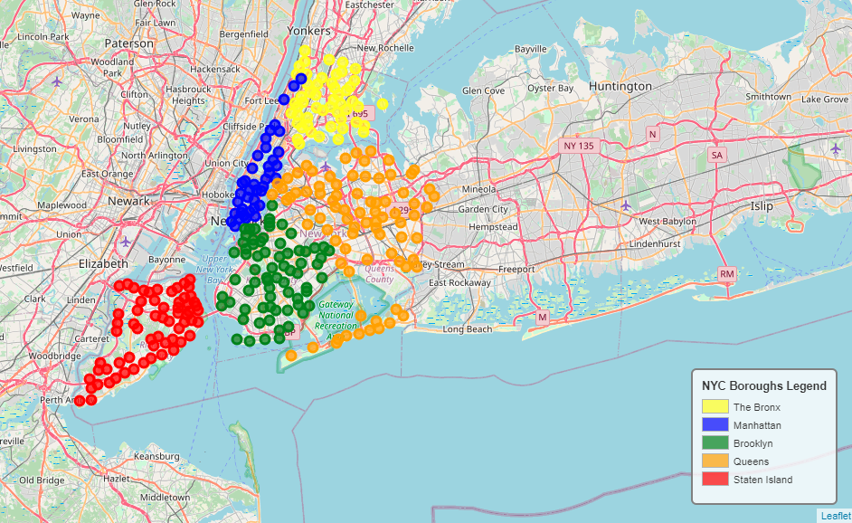
New York City
5 boroughs and 306 neighborhoods

Slide 7
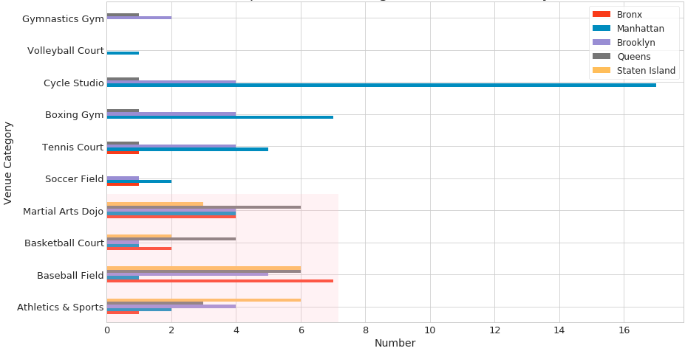
NYC Sports Venues
Common Sports Venues

Slide 8
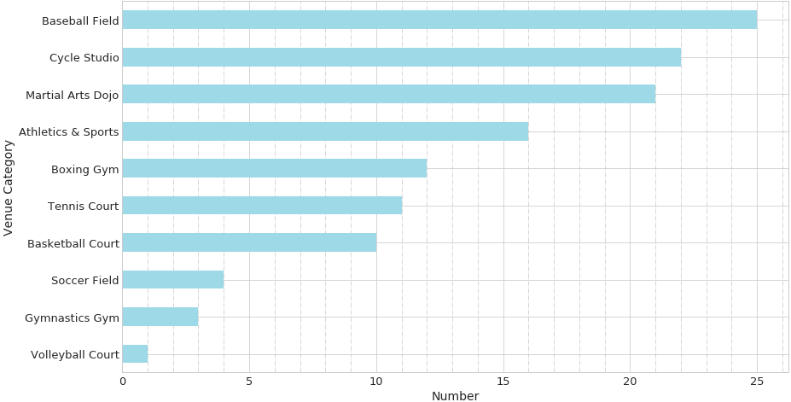
NYC Sports Venues by Totals

Slide 9
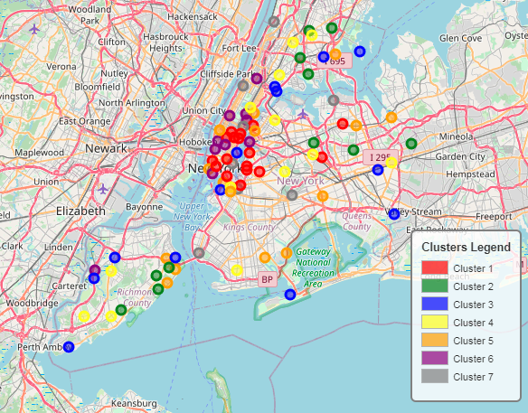
NYC Sports Clusters

Slide 10
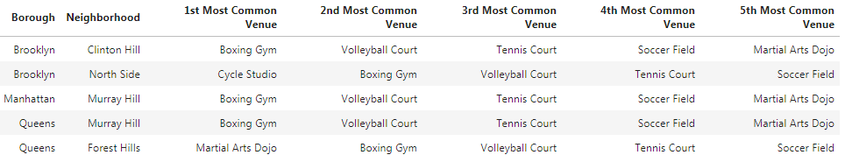
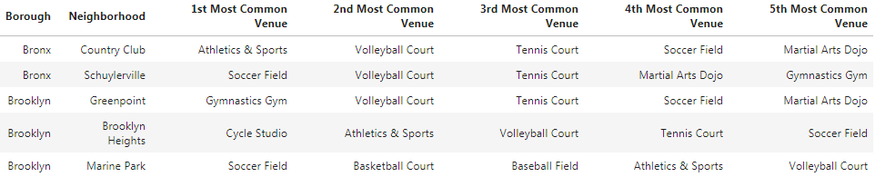
Clusters 1 & 2
Mixed sports

Slide 11
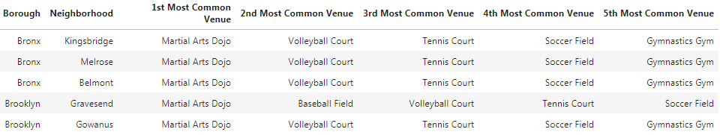
Cluster 3
Martial Arts

Slide 12
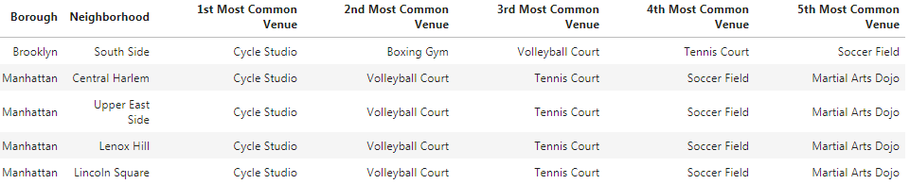
Cluster 4
Cycle Studios

Slide 13
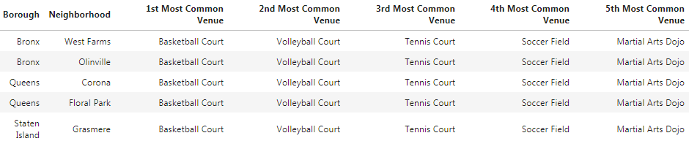
Cluster 5
Basketball Court

Slide 14
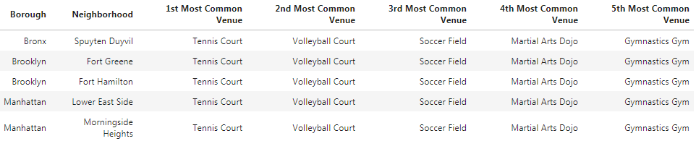
Cluster 6
Tennis Court

Slide 15
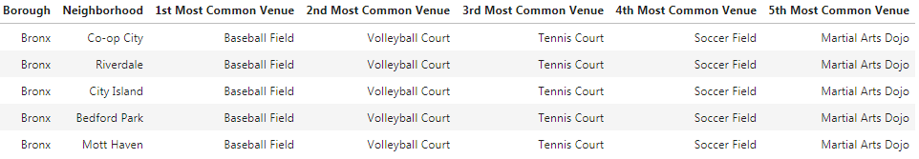
Cluster 7
Baseball Field

Slide 16
Discussion (1)
The results obtained indicates that New York City can be divided into 7 sports venue clusters
Each clusters is characterised by a collection of common sports engaged in in the cluster.
Baseball Fields (25) are the most common sports venues in New York city, followed by Cycle Studios (22), Martial Arts Dojos (21), Athletics & Sports (16), Boxing Gyms (12), Tennis Courts (11), basket Ball Courts (10), Soccer Fields (4), Gymnastics Gyms (3) and Volley Ball Courts (1).

Slide 17
Discussion (2)
Cluster 1 and Cluster 2 are mixed between the different sports.
The most common sports venues in Clusters 3 and 4 are Martial Arts Dojos and Cycle Studios, respectively.
Cluster 5 is predominantly known for Basketball Courts, whereas in Cluster 6 consists of mostly Tennis Courts. The no.1 sports venue in New York City, Baseball Fields, is found in Cluster 7.
By looking at the commonality of sports venues between clusters, the marketing teams can be optimally deployed. For instance, the marketing team specialising in gymnastics should mainly focus on Clusters 6, 3 and 2.

Slide 18
Conclusion
The marketing team can use the results to decide which sports categories to focus on and in which neighboorhoods of New York City the target markets are.
It can also be used to determine in which neighboorhoods opportunities exist for introductions of new sports activities and creating new markets.

